Slide 1
Department of MCA
Programming using C# .Net -18MCA51
Module 5: Web App Development and Data Access using ADO.NET
Handling By
Nirupama K
Asst. Prof. Dept. of MCA

Slide 2
Basics of Web
In its simplest form, a web page is nothing more than an HTML (HyperText Markup Language) document (with the extension .html or .htm) that describes to a web browser the docu-ment’s content and how to format it
URIs and URLs
URIs (Uniform Resource Identifiers) identify resources on the Internet. URIs that start with
http:// are called URLs (Uniform Resource Locators).

Slide 3
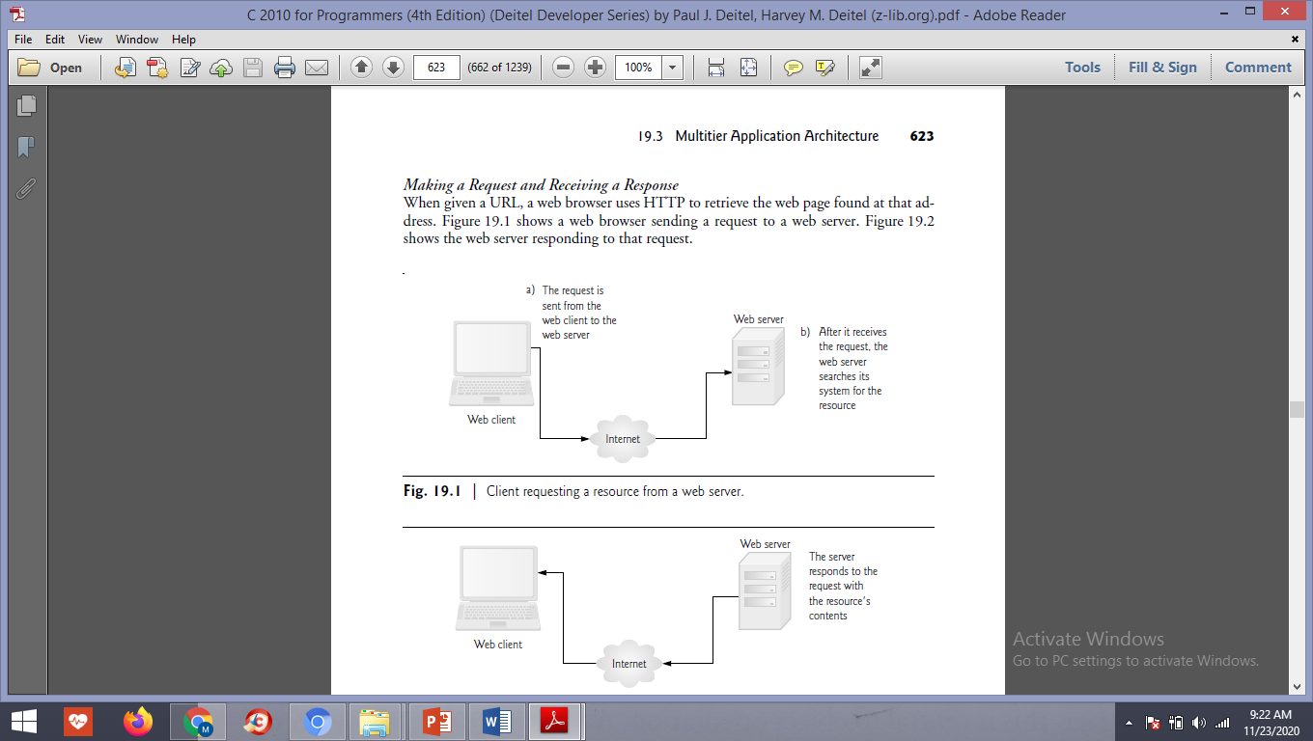

Slide 4
Multitier Application Architecture
Information Tier
The information tier (also called the bottom tier) maintains the application’s data. This tier typically stores data in a relational database management system.
For example, a retail store might have a database for storing product information, such as descriptions, prices and quantities in stock. The same database also might contain customer information, such as user names, billing addresses and credit card numbers
This tier can contain multiple databases, which together comprise the data needed for an application.
Business Logic
The middle tier implements business logic, controller logic and presentation logic to control interactions between the application’s clients and its data

Slide 5
The middle tier acts as an intermediary between data in the information tier and the application’s clients. The middle-tier controller logic processes client requests (such as requests to view a product catalog) and retrieves data from the database.
The middle-tier presentation logic then pro-cesses data from the information tier and presents the content to the client. Web applica-tions typically present data to clients as web pages.
Business logic in the middle tier enforces business rules and ensures that data is reliable
before the server application updates the database or presents the data to users
Business rules dictate how clients can and cannot access application data, and how applications pro-cess data. For example, a business rule in the middle tier of a retail store’s web-based appli-cation might ensure that all product quantities remain positive.
A client request to set a negative quantity in the bottom tier’s product information database would be rejected by the middle tier’s business logic

Slide 6
Client Tier
The client tier, or top tier, is the application’s user interface, which gathers input and dis-plays output. Users interact directly with the application through the user interface (typi-cally viewed in a web browser), keyboard and mouse.
In response to user actions (for example, clicking a hyperlink), the client tier interacts with the middle tier to make re-quests and to retrieve data from the information tier. The client tier then displays to the user the data retrieved from the middle tier. The client tier never directly interacts with the information tier

Slide 7
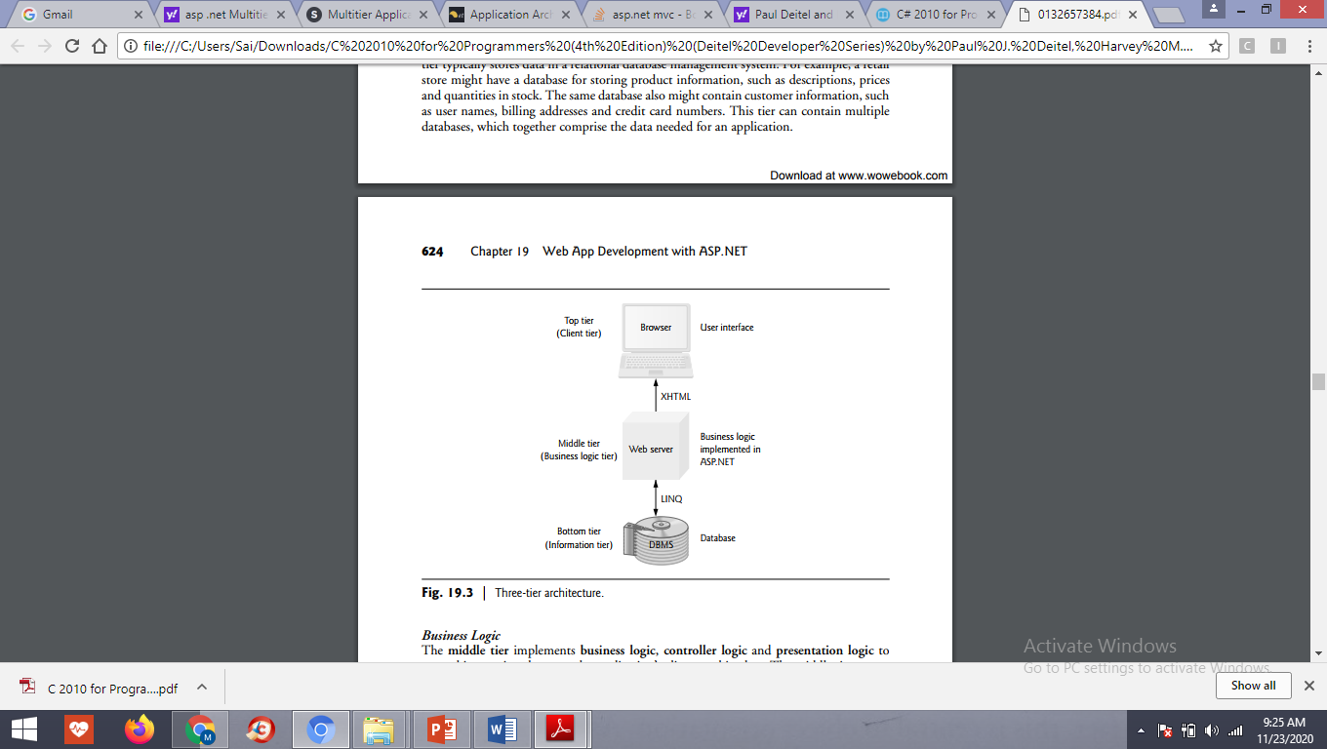

Slide 8
Introducing new features of ASP .NET 4.0
ASP .NET core services
ASP .NET web Forms
Dynamic Data
ASP .NET Chart control
Microsoft AJAX functionality
Improved CSS capability
ASP .NET core services
Refactoring of the web.config file
Output caching
Auto start web application
Redirecting a page
Compressing session state
Range of allowable URLs

Slide 9
Dynamic data
Including a Rapid Application Development, It help to data driven web application
Automatic validation
DynamicControl control
DynamicDataManager control
DynamicEntity control
DynamicFilter control
DynamicHyperink control
Dynamicvalidator control

Slide 10
Creating a sample website
Setting meta tags by using the Meta keywords

Slide 11
Validation Controls
RequiredFieldValidator
RangeValidator
CompareValidator
RegularExpressionValidator
CustomValidator
ValidationSummary
RequiredFieldValidator Control
The RequiredFieldValidator control ensures that the required field is not empty. It is generally tied to a text box to force input into the text box.
<asp:RequiredFieldValidator ID="rfvcandidate"
runat="server" ControlToValidate ="ddlcandidate"
ErrorMessage="Please choose a candidate"
InitialValue="Please choose a candidate">
</asp:RequiredFieldValidator>

Slide 12
RangeValidator Control
The RangeValidator control verifies that the input value falls within a predetermined range.
Properties | Description
Type | It defines the type of the data. The available values are: Currency, Date, Double, Integer, and String.
MinimumValue | It specifies the minimum value of the range.
MaximumValue | It specifies the maximum value of the range.
CompareValidator Control
The CompareValidator control compares a value in one control with a fixed value or a value in another control.
Properties | Description
Type | It specifies the data type.
ControlToCompare | It specifies the value of the input control to compare with.
ValueToCompare | It specifies the constant value to compare with.
Operator | It specifies the comparison operator, the available values are: Equal, NotEqual, GreaterThan, GreaterThanEqual, LessThan, LessThanEqual, and DataTypeCheck.

Slide 13
RegularExpressionValidator
The RegularExpressionValidator allows validating the input text by matching against a pattern of a regular expression. The regular expression is set in the ValidationExpression property.
The following table summarizes the commonly used syntax constructs for regular expressions:
Character Escapes | Description
\b | Matches a backspace.
\t | Matches a tab.
\r | Matches a carriage return.
\v | Matches a vertical tab.
\f | Matches a form feed.
\n | Matches a new line.
\ | Escape character.

Slide 14
CustomValidator
The CustomValidator control allows writing application specific custom validation routines for both the client side and the server side validation.
The client side validation is accomplished through the ClientValidationFunction property. The client side validation routine should be written in a scripting language, such as JavaScript or VBScript, which the browser can understand.
The server side validation routine must be called from the control's ServerValidate event handler. The server side validation routine should be written in any .Net language, like C# or VB.Net.
ValidationSummary
The ValidationSummary control does not perform any validation but shows a summary of all errors in the page. The summary displays the values of the ErrorMessage property of all validation controls that failed validation.
The following two mutually inclusive properties list out the error message:
ShowSummary : shows the error messages in specified format.
ShowMessageBox : shows the error messages in a separate window.

Slide 15
Validation Groups
Complex pages have different groups of information provided in different panels. In such situation, a need might arise for performing validation separately for separate group. This kind of situation is handled using validation groups.
To create a validation group, you should put the input controls and the validation controls into the same logical group by setting their ValidationGroup property.
Example
The following example describes a form to be filled up by all the students of a school, divided into four houses, for electing the school president. Here, we use the validation controls to validate the user input.

